Slide 1
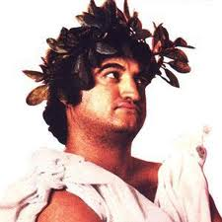
Greek and Latin Roots
Instructions:
Recreate the following frayer model on your paper. Put the appropriate information in each box.

Slide 2
Greek and Latin Roots
Define the meaning Draw a picture that illustrates of the root. the root’s meaning.
To Throw
List 3 derivatives for the Use one the derivatives
root. correctly in a sentence.
Ject

Slide 3
Greek and Latin Roots
Define the meaning Draw a picture that illustrates of the root. the root’s meaning.
Bad or Evil
List 3 derivatives for the Use one the derivatives
root. correctly in a sentence.
Mal

